Slide 1



COMP5523
Group Project Introduction
2026/27 Semester 1

Slide 2
00 Outline
Project Specification
Group Presentation
Project Report
Assessment Rubrics

Slide 3
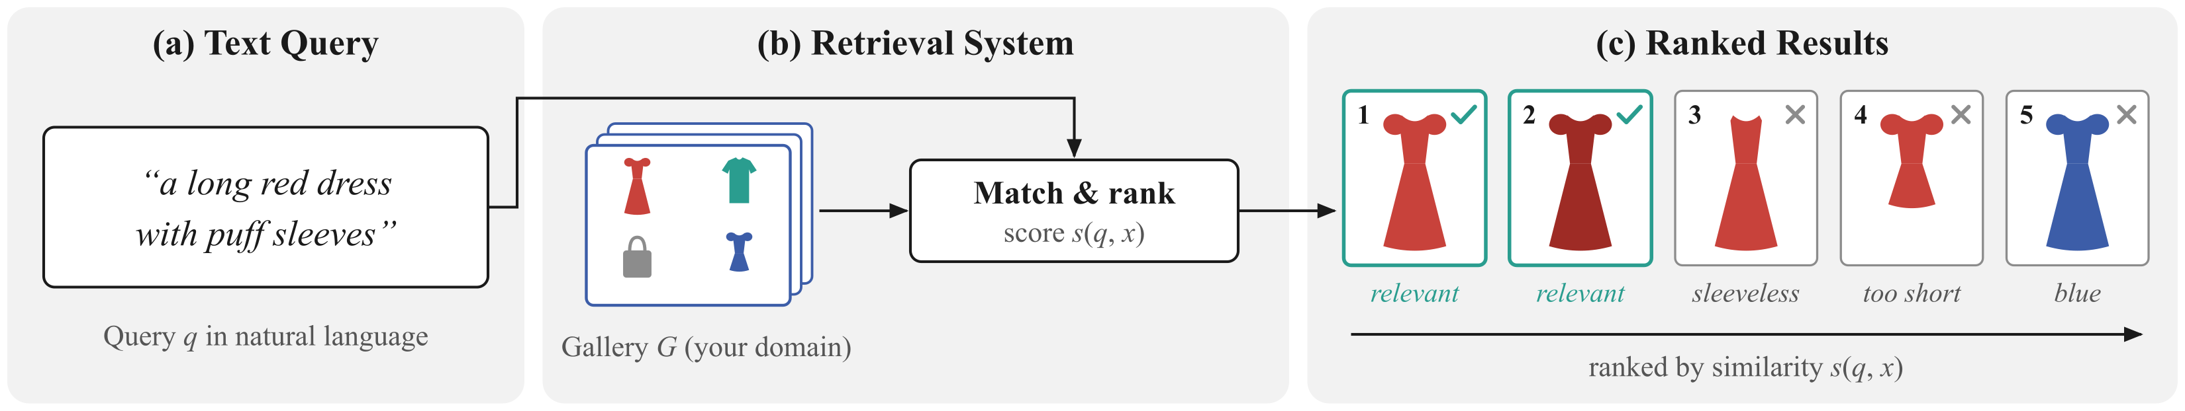
01 Project Specification
Topic: Domain-Specific Text-to-Image Retrieval
Task: Build a text-to-image retrieval system for an application domain of your choice.
Input: A natural-language query, such as “a long red dress with puff sleeves”.
Output: A ranked list of the most relevant images from the gallery.
Team: 4 to 6 members per group.
Example (fashion domain): relevance depends on category, color, length, and sleeves.

Slide 4
01 Project Specification
Domain and Relevance
Domain examples: Fashion and products, food and recipes, artworks and painting styles, landmarks and buildings, plants and animals.
Scope: Choose a specific domain, or a general one if preferred.
Relevance: Define what relevance means in your domain (e.g., matching the object category, attributes, style, or place in the query), and explain how your system measures it.
User needs: Explain who will use the system and why text-to-image search is useful in this domain.

Slide 5
01 Project Specification
Possible Components: Representation and Search
The system may include, but is not limited to:
Cross-modal representation: Use comparable text and image representations, e.g., contrastively trained vision-language models such as CLIP.
Image descriptions: Use captions or object/attribute tags, then match these descriptions with the text query.
Similarity search and indexing: Use cosine similarity and nearest-neighbor search, with approximate search for large galleries.

Slide 6
01 Project Specification
Possible Components: Adaptation and Refinement
The system may include, but is not limited to:
Domain adaptation: Fine-tune on domain image-text pairs, design prompt templates, or rewrite and expand user queries.
Re-ranking: Use a stronger vision-language model or object detection to verify details mentioned in the query.
Query understanding: Handle attributes, counts, or spatial relations in more complex queries.
User interface: Let users type queries and browse the ranked results.

Slide 7
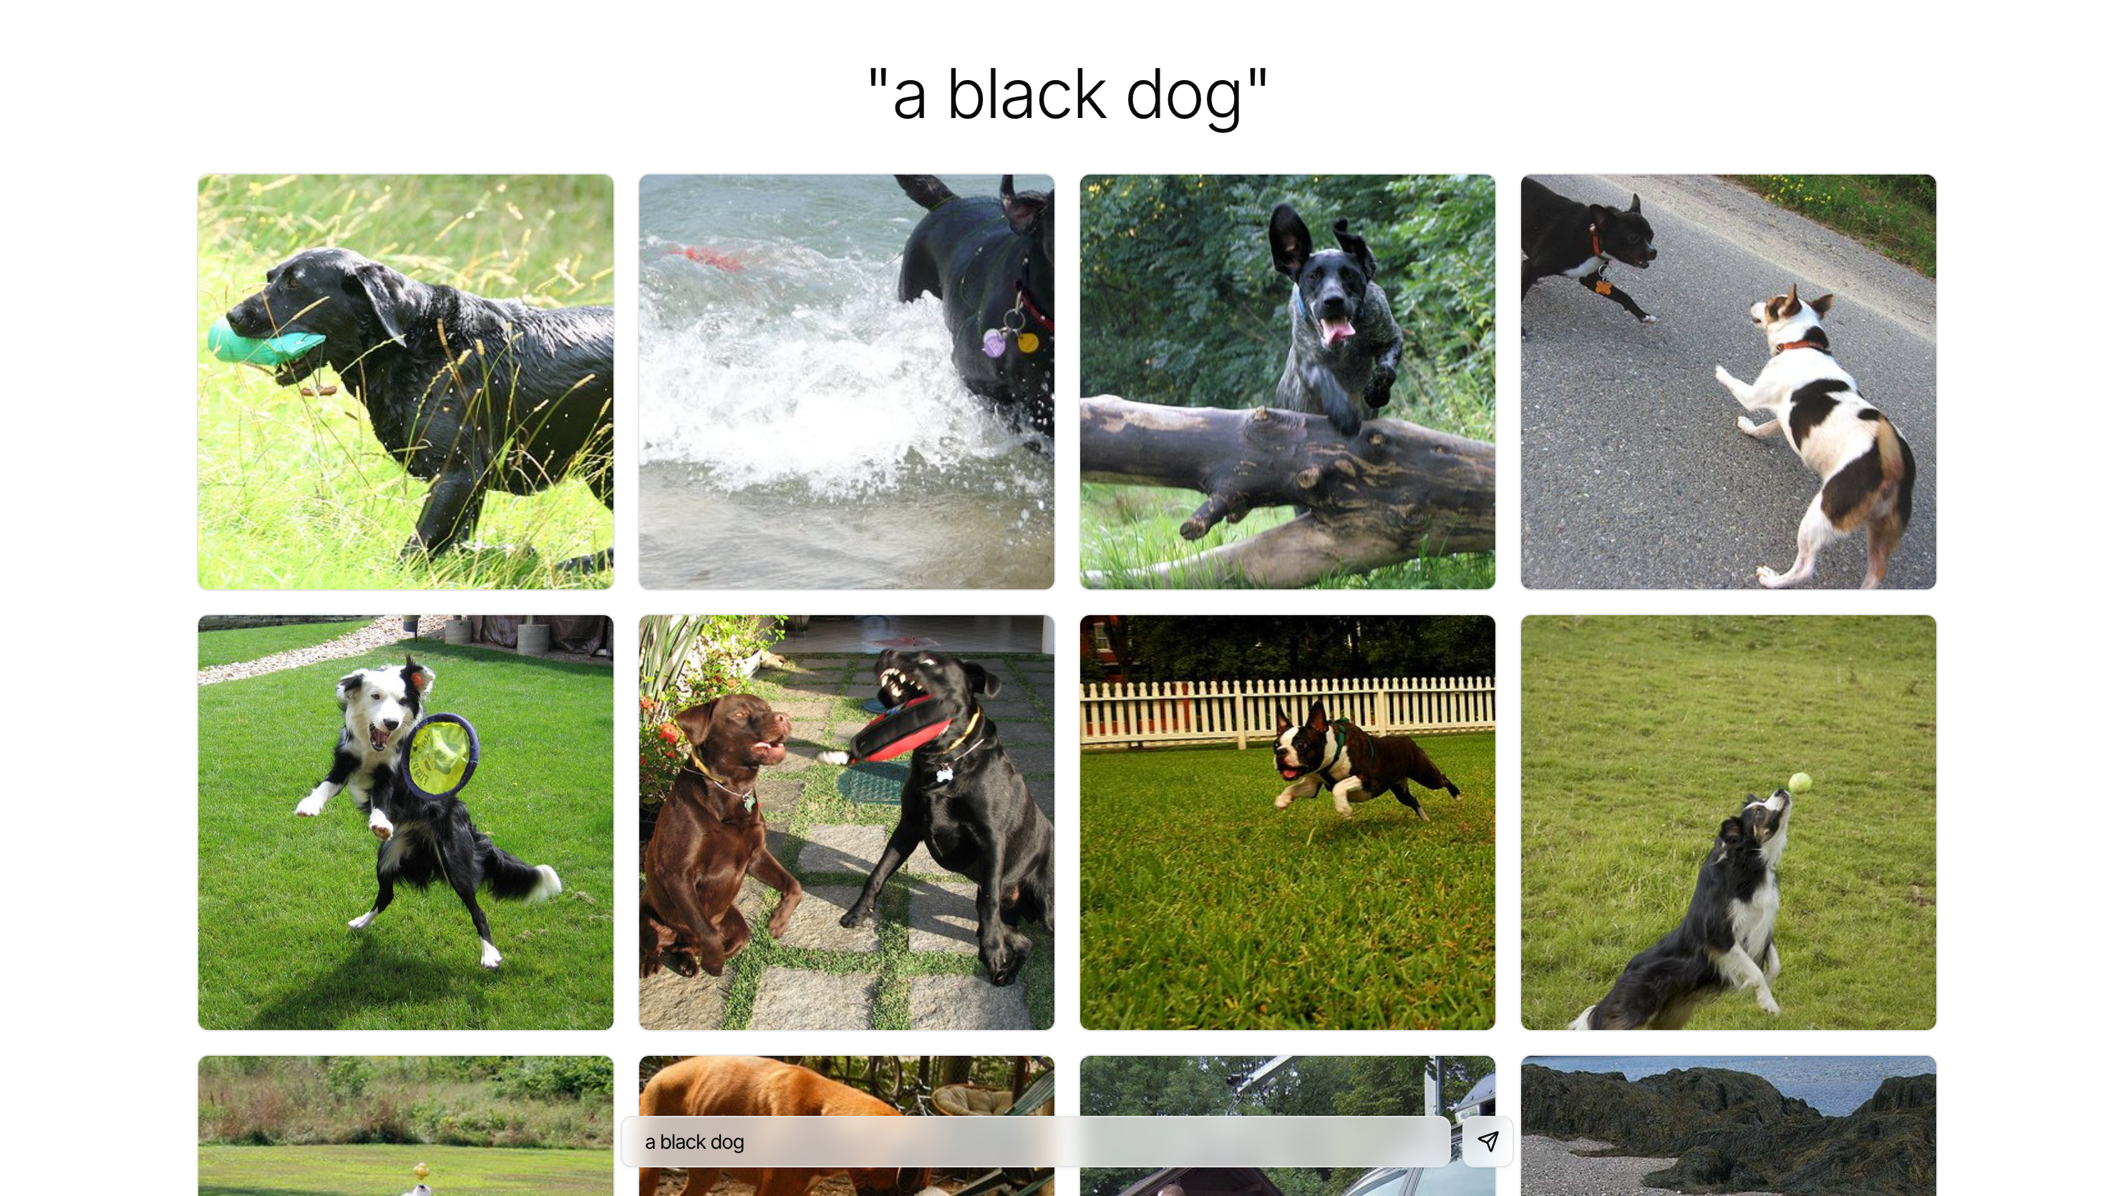
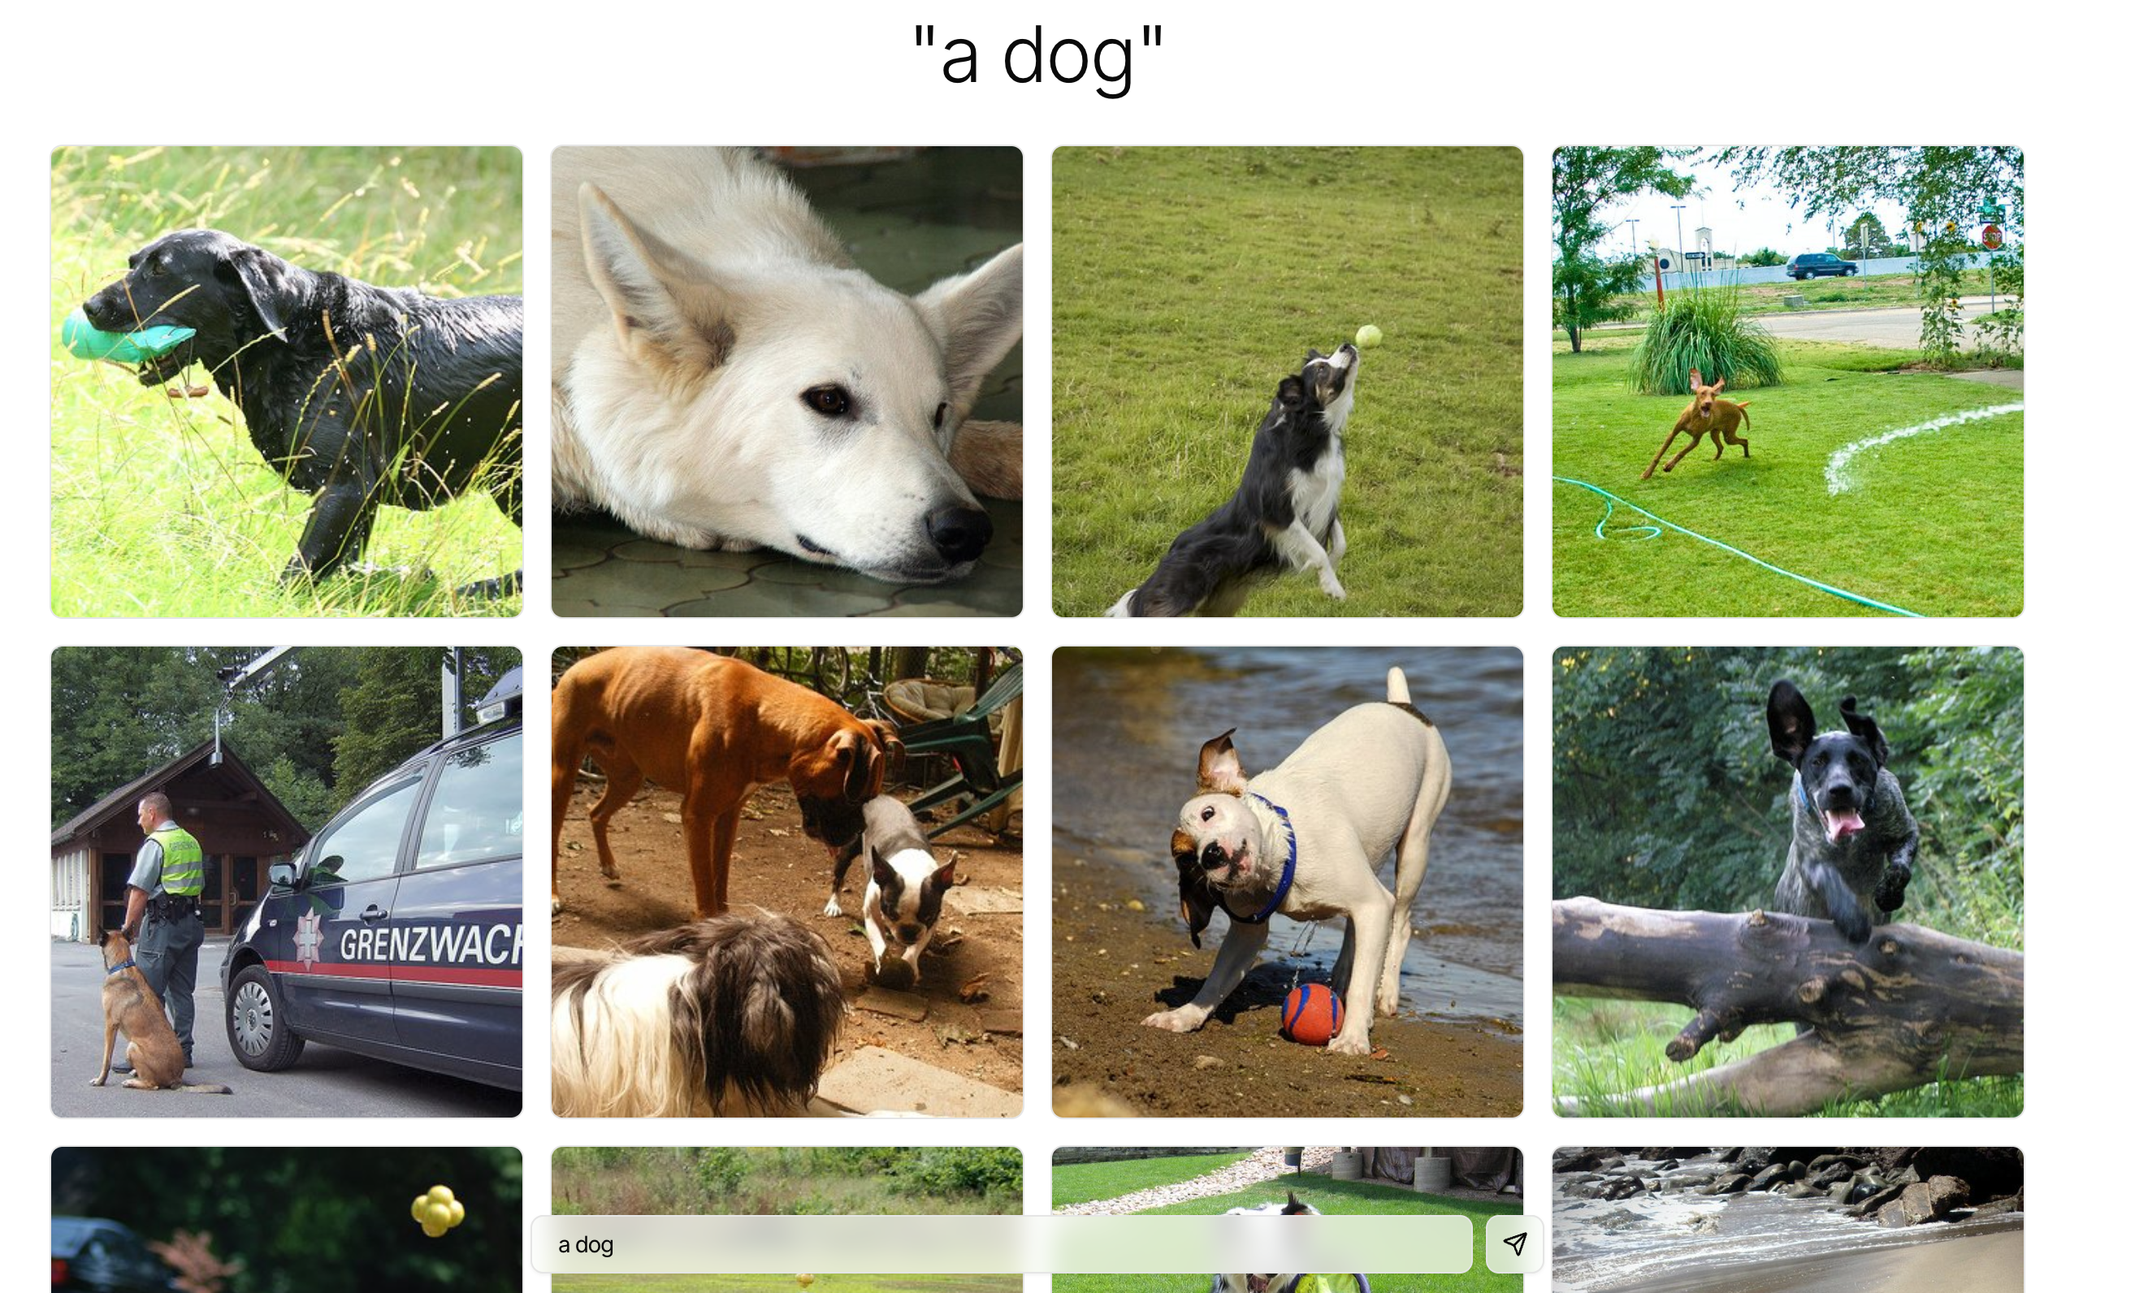
01 Project Specification
Live Demo: A Minimal Text-to-Image Search System
Gallery: 250 everyday photos from Flickr30k, each with up to five human-written captions.
Pipeline: Match the text query with image captions using text embeddings and cosine similarity. The model never looks at the pixels.
huggingface.co/spaces/shadow-llm/COMP5523-Image-Search-Demo

Slide 8
01 Project Specification
Project Steps
Domain definition and data preparation: Define the domain and organize the image gallery. The domain can also be general if preferred.
Evaluation set construction: Prepare text queries and their ground-truth relevant images.
Algorithm design: Design and compare text/image representations, similarity measures, and ranking approaches. Justify your choices.
System implementation: Integrate models and tools into a working system with a text-query interface.
Performance evaluation: Evaluate retrieval quality and analyze failure cases.

Slide 9
01 Project Specification
Data and Evaluation Set
Gallery: Use public datasets, web images, or photos taken by group members. Remove duplicates and corrupted images as needed.
Data use: Respect licenses and avoid collecting or exposing personal data, such as searching for people by their faces.
Evaluation set: Construct your own test set with text queries and ground-truth relevant images. State the relevance criteria.
Queries and labels: Groups are encouraged to write queries and label relevant images, and may adapt public datasets.
Sources and annotation: Cite public datasets. For group-collected or annotated data, describe the collection or annotation process.

Slide 10
01 Project Specification
Performance Evaluation
Retrieval quality: Each group must use at least one measure appropriate to its domain (e.g., Precision@K, Recall@K, or mAP) and justify its choice.
Evaluation protocol: Explain how you evaluate the system on your evaluation set.
Failure cases: Analyze where the system retrieves irrelevant images or misses relevant images.
Optional efficiency evaluation: For example, query latency.

Slide 11
01 Project Specification
Use of AI Tools
Use: The use of AI tools is not restricted.
Disclosure: Clearly disclose every use of AI, stating where and how it was used.
Collaboration: In both the presentation and report, explain which parts were done by group members and which by AI tools.
Checking and integration: Explain how AI-generated outputs were checked and integrated into the project.

Slide 12
02 Group Presentation
Presentation Date and Format
Date: Wednesday, November 18, 2026
Time and venue: 18:30–21:20, TU101
Duration: 7 minutes per group.
Q&A: No Q&A session.
A Best Presentation award will be given at the end.

Slide 13
02 Group Presentation
Presentation Process
Presenter(s) join the zoom meeting in advance; share screen when start presenting;
Please install Zoom, sign in with your PolyU account, grant screen-sharing and voice permission in advance.
REMEMBER: Setup time also counts toward your 7-minute presentation time.
The professor and TAs will evaluate and score during the presentation.
Presentation Order
Will be released before presentation

Slide 14
02 Group Presentation
Presentation Content
Domain and task: Introduce the chosen domain, task settings, and challenges.
Methods: Explain the methodologies and system design.
Results: Show system functionality, features, effectiveness, and results on your evaluation set.
Recorded demonstration: Show how the system retrieves relevant images for real text queries.
AI collaboration: Explain which parts were done by group members and which by AI tools.

Slide 15
03 Project Report
Report Content and Submission
Deadline: 23:59 on Wednesday, November 25, 2026
Task and data: Describe the domain, task setting, background, and evaluation set construction.
Development and results: Explain the development process, challenges, methodologies, outcomes, and evaluation results.
Contributions: State each group member’s role and individual contributions.
AI use statement: Explain where and how AI was used, what members and AI each did, and how AI outputs were checked and integrated.

Slide 16
03 Project Report
Report Format
Length: Up to 8 A4 portrait pages, plus unlimited pages for references in APA format and for the peer review.
Text: 12-point Times New Roman, single line spacing, one column, and 1-inch margins.
Front matter: No table of contents or cover page is needed.
Figures and tables: Encouraged to make the report clear and easy to understand.

Slide 17
03 Project Report
Peer Review
Assignment: After all presentations, each group will be assigned another group to review.
Basis: Review the assigned group's presentation and demonstration.
Content: Comment on the task setting, methodology, evaluation, and system functionality, and give specific, constructive suggestions.
Submission: Include the review in your project report. It does not count toward the 8-page limit.
Grading: The review is used only to grade the reviewing group. It will not be used to grade the reviewed group.

Slide 18
04 Assessment Rubrics
Assessment Overview
Project weight: 15% of the final course grade.
Criteria: Appropriateness, Soundness, Excitement, Presentation, Writing, and Peer Review. Each contributes up to 2.5%.
Achievement levels: 2.5%, 2%, 1.5%, 1%, and 0.5% for each criterion.

Slide 19
04 Assessment Rubrics
Scoring Rubrics
1) Appropriateness
  Task settings, challenges, methodologies, and system functionality are highly appropriate and relevant. (2.5%)
  Task settings, challenges, methodologies, and system functionality are mostly appropriate and relevant. (2%)
  Task settings, challenges, methodologies, and system functionality demonstrate some level of appropriateness. (1.5%)
  Task settings, challenges, methodologies, and system functionality are inadequate. (1%)
  Task settings, challenges, methodologies, and system functionality are inappropriate. (0.5%)

Slide 20
04 Assessment Rubrics
Scoring Rubrics
2) Soundness
  The project demonstrates a comprehensive and well-organized development process with clear and logical explanations. (2.5%)
  The project demonstrates a mostly comprehensive and well-organized development process with mostly clear and logical explanations. (2%)
  The project demonstrates some level of organization and logic in the development process, but with some unclear explanations. (1.5%)
  The project demonstrates limited organization and logic in the development process and provides inadequate explanations. (1%)
  The project is disorganized and lacks a clear or logical development process with unclear or illogical explanations. (0.5%)

Slide 21
04 Assessment Rubrics
Scoring Rubrics
3) Excitement
  The project presents innovative and engaging ideas that consistently capture the attention of the audience. (2.5%)
  The project presents engaging ideas that mostly capture the attention of the audience, but may lack consistency. (2%)
  The project presents some level of engagement, but with areas of improvement and inconsistent audience attention. (1.5%)
  The project lacks innovation and fails to capture the audience's excitement consistently. (1%)
  The project lacks excitement or fails to engage the audience. (0.5%)

Slide 22
04 Assessment Rubrics
Scoring Rubrics
4) Presentation
  The presentation is highly polished and professional, with excellent delivery and effective use of visual aids. (2.5%)
  The presentation is mostly polished and professional, with good delivery and adequate use of visual aids. (2%)
  The presentation has some areas of improvement in polish and professionalism, and delivery may lack consistency. (1.5%)
  The presentation lacks polish and professionalism, and delivery is weak. Visual aids are ineffective. (1%)
  The presentation is poorly executed, making it difficult to follow, with ineffective use of visual aids. (0.5%)

Slide 23
04 Assessment Rubrics
Scoring Rubrics
5) Writing
  The project report is well-written, with clear and concise explanations of ideas and proper use of grammar and formatting. (2.5%)
  The project report is mostly well-written, with mostly clear and concise explanations of ideas and mostly proper use of grammar and formatting. (2%)
  The project report is adequately written, with some clarity issues and inconsistent use of grammar and formatting. (1.5%)
  The project report is poorly written, with unclear or confusing explanations and significant errors in grammar and formatting. (1%)
  The project report is very poorly written, with numerous clarity and formatting errors, making it difficult to understand. (0.5%)

Slide 24
04 Assessment Rubrics
Scoring Rubrics
6) Peer Review
  The review is highly relevant to the reviewed group's work and highly constructive, providing specific, well-justified, and actionable suggestions. (2.5%)
  The review is relevant to the reviewed group's work and mostly constructive, providing some specific and actionable suggestions. (2%)
  The review is relevant to the reviewed group's work, but its suggestions are general or of limited constructiveness. (1.5%)
  The review is only partially relevant to the reviewed group's work and provides little constructive feedback. (1%)
  The review is irrelevant to the reviewed group's work or provides no constructive feedback. (0.5%)

Slide 25
Best of luck
with your group project!

